Slide 1

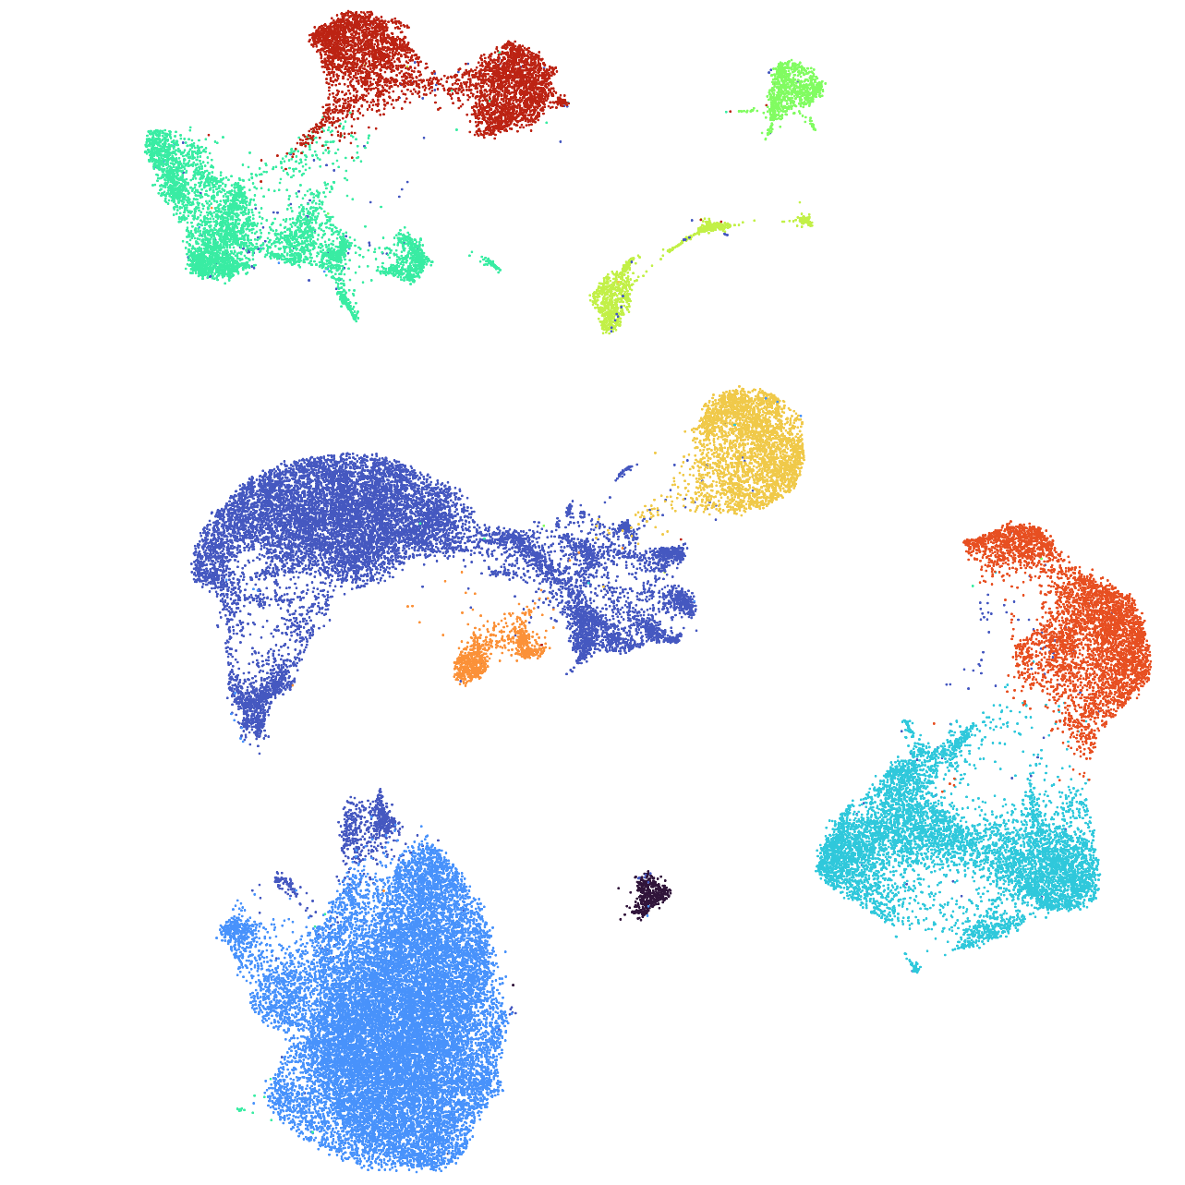


scscape Pipeline Overview ScRNAseq in the Cloud
MDIBL Comparative Genomics and Data Science Core

Slide 2
Pipeline
01
02
03
04
Make Seurat
Normalize QC
Doublet Finder
Merge
05
06
07
08
PCA
Integration
Neighbors Clusters
Markers
Plotting

Slide 3
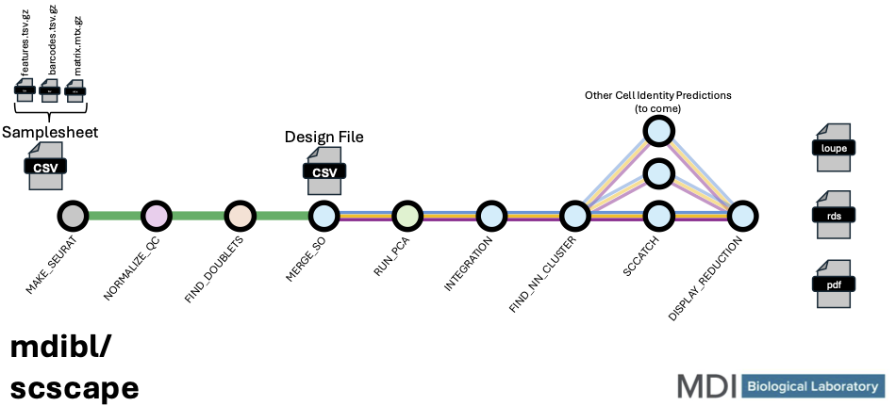
Pipeline

Slide 4


01
Make Seurat
By
Sample

Slide 5
Make Seurat – MEX format
features.tsv | barcodes.tsv | matrix.mtx
ENSMUSG00000100764 Gm29155
ENSMUSG00000100635 Gm29157
ENSMUSG00000100480 Gm29156
ENSMUSG00000051285 Pcmtd1
ENSMUSG00000097797 Gm26901
ENSMUSG00000103067 Gm30414
ENSMUSG00000026312 Cdh7
ENSMUSG00000039748 Exo1
ENSMUSG00000104158 Becn2
ENSMUSG00000057363 Uxs1
ENSMUSG00000047216 Cdh19
ENSMUSG00000101253 Gm29088
ENSMUSG00000038702 Dsel
ENSMUSG00000101453 Gm28189
AAACCTGCAAGCTGTT-1
AAACCTGCACAGCGTC-1
AAACCTGTCGGATGTT-1
AAACGGGCAGGATTGG-1
AAACGGGCATCGATGT-1
AAAGATGAGCGTGTCC-1
AAAGATGCATTACGAC-1
AAAGATGGTTTGTGTG-1
AAAGATGTCACATGCA-1
AAAGATGTCAGCCTAA-1
AAAGATGTCCTTGCCA-1
AAAGCAAAGAGTACAT-1
AAAGCAACATAGACTC-1
AAAGTAGCACCAACCG-1
%%MatrixMarket matrix coordinate integer general
%metadata_json: {"software_version": "cellranger-8.0.0", "format_version": 2}
33596 1760 2893894
35 1 1
39 1 1
54 1 2
71 1 1
81 1 1
86 1 1
132 1 7
156 1 1
177 1 15
185 1 1
248 1 1
Notes:
From our output from scrnaseq we have MEX format count data:
These are normally gzipped, but I have unzipped them to to show what they look like:
Matrix file points to the other two files.
Based on the numbers on the third row, can we deduce which column represents which which.
Ask any idea on why we would structure our count this way? Reference Joel’s talk!!!! 00000 counts for a many genes.
And based on how may barcodes we have, this is the filtered output.

Slide 6
Make Seurat – MEX format
features.tsv | barcodes.tsv | matrix.mtx
ENSMUSG00000000001 Gene01
ENSMUSG00000000002 Gene02
ENSMUSG00000000003 Gene03
ENSMUSG00000000004 Gene04
ENSMUSG00000000005 Gene05
ENSMUSG00000000006 Gene06
ENSMUSG00000000007 Gene07
ENSMUSG00000000008 Gene08
ENSMUSG00000000009 Gene09
ENSMUSG00000000010 Gene10
ENSMUSG00000000011 Gene11
ENSMUSG00000000012 Gene12
ENSMUSG00000000013 Gene13
ENSMUSG00000000014 Gene14
AAACCTGCAAGCTGTT-1
AAACCTGCACAGCGTC-1
AAACCTGTCGGATGTT-1
AAACGGGCAGGATTGG-1
AAACGGGCATCGATGT-1
AAAGATGAGCGTGTCC-1
AAAGATGCATTACGAC-1
AAAGATGGTTTGTGTG-1
AAAGATGTCACATGCA-1
AAAGATGTCAGCCTAA-1
AAAGATGTCCTTGCCA-1
AAAGCAAAGAGTACAT-1
AAAGCAACATAGACTC-1
AAAGTAGCACCAACCG-1
%%MatrixMarket matrix coordinate integer general
%metadata_json: {"software_version": "cellranger-8.0.0", "format_version": 2}
33596 1760 2893894
1 1 1
4 1 3
8 1 2
14 1 1
12 2 1
1 2 1
4 2 7
4 3 1
7 3 15
2 3 1
8 3 1
Cell AAACCTGTCGGATGTT-1 has 15 counts of Gene07.
Notes:
Now we have a “fake” demonstration example.
Red matches with column 1 indicating the feature.
Blue matched with column 2 indicating the barcodes.
Column 3 is the UMI count.
ENTER
Just walk through the example. Don’t ask them to do it.

Slide 7
Make Seurat
SO
ME
X
Coarse Filtering of Data
Remove Cells with fewer than a designated number of genes
Default set to 200
Remove Genes with expressed in fewer than a designated number of cells
Default set to 3
Option to manually remove certain genes.
ie. unannotated genes.
This was not set for us
Notes:
There are two phases of QC.
The first phase, is a rather “uninformed” QC.
What I mean by this is that cells and genes are dealt with irrespective of the other cells and genes within the sample.
For Cell Removal, these cells likely dead cells, or empty droplets with only a little bit of ambient RNA.
For Gene Removal, these genes are irelivant to the analysis as they are hardly being expressed and will only contribute to bogging down the analysis.
Manual Removal of Genes. Genes that you do not want to be a factor in the analysis. One example is if you only wanted to look at the immue system. You could filter out all of the

Slide 8
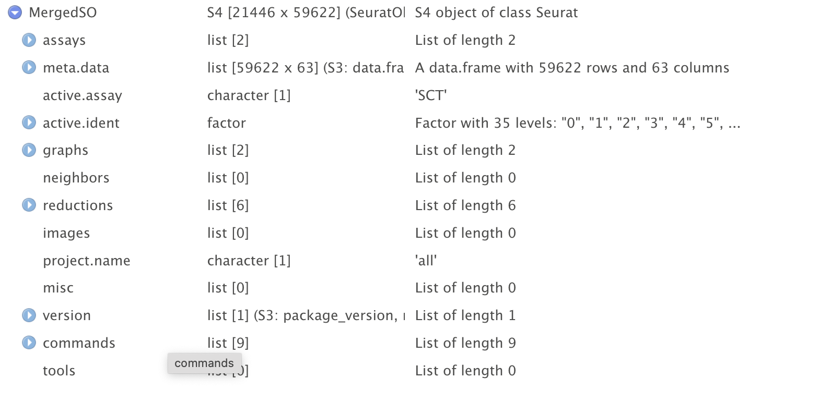
Make Seurat

Slide 9


02
Normalize QC
By
Sample

Slide 10

Normalize QC
SO
Mitochondrial Percent
Cell Cycle Scoring
Thresholds
High Mitochondrial Percentage is indicative of poor quality or dying cells.
Default Set to 10% Maximum
These scores are calculated for both G2M and S Phase and are subsequently regressed out.
Minimum and maximum gene-count and read-count thresholds can be set.
Defaults:
Gene and read count minimum set at 10th percentile.
Gene and read count maximum not set.
Notes:
What reason would we have a maximun on the ncount/nfeatures? What kinds of cells be at the top?
We will discuss normalization later on
Low thresholds is done, to ensure good quality cells.

Slide 11
Normalize QC
SO
Why
Log Normalize
SCTransform
Account for cell-to cell difference
Varying read count per cell
Correct technical biases
Adjust for sequencing depth differences
Reveal true biological differences
Improves data quality
Simple and Fast
Applies log transformation
Struggles with low or zero count genes
More advanced and computationally intensive
Creates a model for each gene, looking at gene expression and variability.
Preforms well for low and zero count genes.
Specifically designed for Single Cell.
Notes:
This normalization is a preliminary normalization and will be rurun in a later step. (REQUIRED FOR CC Scoring)
1. Account for cell-to-cell differences
- Adjust for varying cell sizes and RNA content
- Make gene expression comparable across all cells
2. Correct technical biases
- Adjust for sequencing depth variations
- Reduce batch effects and sample preparation differences
3. Reveal true biological differences
- Separate technical noise from biological signal
- Highlight genuine variations between cell types
4. Enable accurate comparisons
- Between cells, groups, or experiments
- Essential for reliable downstream analyses
5. Improve data quality
- Enhance clustering and cell type identification
- Increase sensitivity in detecting differential expression
Key Takeaway: Normalization helps us focus on real biological differences by minimizing technical variations in the data.
Log Normalize:
1. Simple and fast method
2. Scales data and applies log transformation
3. Works well for many standard analyses
4. May struggle with very low or zero counts
5. Requires separate steps for scaling and feature selection
SCTransform:
1. More advanced, computer-intensive method
2. Models relationship between gene expression and variability
3. Better handles differences in sequencing depth
4. Performs well with low counts and zero-inflated data
5. Combines normalization, scaling, and feature selection in one step
Key Difference: SCTransform often provides better results, especially for complex datasets, but is more computationally demanding than Log Normalize.
This format provides a clear, side-by-side comparison that highlights the main differences between the two methods without delving into technical details, making it accessible for the target audience.

Slide 12
Normalize
300
SO
200
Count /
Total Reads
Cell1 Cell2 Cell3
Gene A 100/350 150/525 50/175
Gene B 50/350 75/525 25/175
Gene C 200/350 300/525 100/175
Count
1
5
0
Multiply By Scale Factor
Cell1 Cell2 Cell3
Gene A (100/350*10000)+1 (150/525*10000)+1 (50/175*10000)+1
Gene B (50/350*10000)+1 (75/525*10000)+1 (25/175*10000)+1
Gene C (200/350*10000)+1 (300/525*10000)+1 (100/175*10000)+1
1
0
0
100
75
natural log transformation
50
5
0
25
Cell 1
Cell 2
Cell 3
350
525
175
Total Reads
Notes:
Analogy:
US health study.
Each state is a cell.
Each gene is a heath metric, heath attacks and obesity.
If you were to take the raw data, the state with the largest population would probably end up being the most "unheathy"
Which is why we want to normalize.
Per capita: divided by the population.

Slide 13
03
Doublet Finder
By
Sample

Slide 14
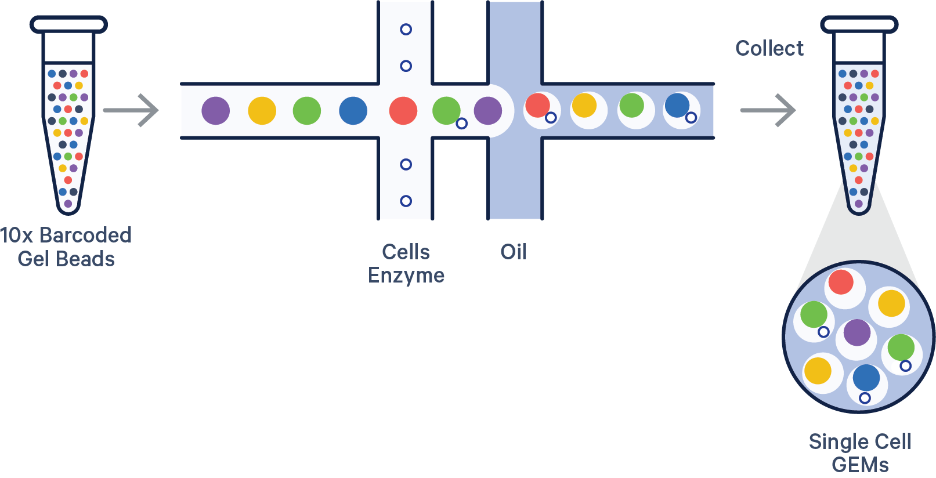
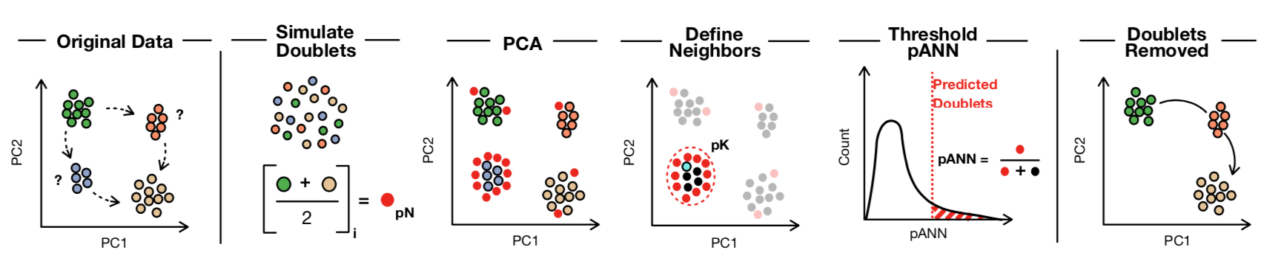
Doublet Finder
SO
What is a Doublet
Doublet Finder Overview
The 10x chromium technology is a droplet-based meaning
2 cells may sneak into the same droplet getting assigned the same barcode.
Generate artificial doublets from existing ScRNAseq data.
Pre-process combined rea and artificial data.
3. Performs PCA and use the PC distance matrix to find each cell’s proportion of artificial k nearest neighbors (paNN)
Rank order and threshold pANN values according to expected doublet number.
Notes:
FIG FROM 10x https://www.10xgenomics.com/blog/the-next-generation-of-single-cell-rna-seq-an-introduction-to-gem-x-technology
WHAT TYPE OF DOUBLETS WILL BE DIFFICULT TO FIND???
DoubletFinder can be broken up into 4 steps:
(1) Generate artificial doublets from existing scRNA-seq data
(2) Pre-process merged real-artificial data
(3) Perform PCA and use the PC distance matrix to find each cell's proportion of artificial k nearest neighbors (pANN)
(4) Rank order and threshold pANN values according to the expected number of doublets
Doublet finder info and figure from: https://github.com/chris-mcginnis-ucsf/DoubletFinder?tab=readme-ov-file

Slide 15

04
Merge
By
Group

Slide 16
Merge
Merge
Normalize
Scale
Now that QC has been completed for each sample, we can combine them into various analysis groups for the remainder of the pipeline.
Normalize with all cells together.
Still have the same options previously discussed.
Regress out unwanted sources of variation in the data to help to focus on biological signal.
Cell cycle Scores
MT %
Number of Genes or Reads detected per cell.
Etc
Puts all genes on the same scale.
Prevents highly expressed genes from dominating the anaysis
Notes:
Normaization occurs on a cell by cell basis and esures that all cells are treated “equally”
Scalling is the subsequent step and ensures that all genes are treated “equally”

Slide 17
Merge -- Scale
Pre-Scale/Center
Centered
Centered and Scaled
Notes:
https://www.researchgate.net/figure/Illustration-of-the-effect-of-mean-centering-and-variance-scaling-on-process-data-as-in_fig1_333849866
Reduce Range, not variance
Adapted from ^^
Each bar is a gene
Scaling from our health example, well you want to take in all of these metrics, heart attack, obesity etc. But the ccurances of obesity far outweighs the occurances of heart attack. To combat this, we have to scale this so that each metric (gene) will be treated equally.

Slide 18
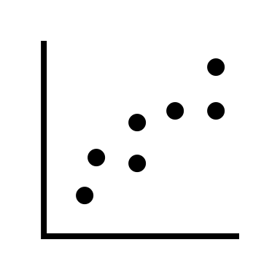
05
PCA
By
Group

Slide 19
Comparing Samples in Varying Dimensions
ENSMUSG00000000002
ENSMUSG00000000002
ENSMUSG00000000002
ENSMUSG00000000002
ENSMUSG00000000002
ENSMUSG00000000001
ENSMUSG00000000001
ENSMUSG00000000001
DIMENSIONAL REDUCTION
Notes:
2 Dimensions are fairly easy to draw relationships between samples and variables. Even 3 Dimensions allows us to be able to perceive associated groupings in our samples. However, when we add a 4th dimension, the comparisons to be made become much harder for us to conceptualize.
To overcome this, we need a way to collectively compare our samples using all relative information. This is especially important in single-cell studies so that we can capture both the large-scale differences while also preserving the underlying fine-granularity of the data.
A way we can accomplish this is by using a method of dimensional reduction. With these methods we are aiming to reduce the complexity of high-dimensional data into a easily digestible format such as a 2 or 3D representation.
One popular way to calculate this reduction is using what is known as a Principle Component Analysis.

Slide 20
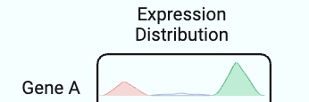
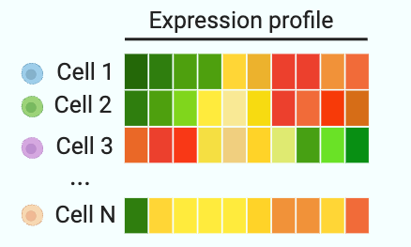

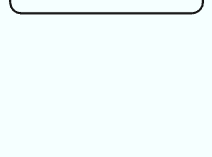
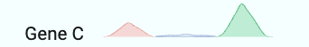
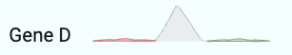
Variable Features and Covariance
Notes:
To set up our understanding of the principle component analysis we first want to understand how the underlying data is structured. In any single cell sequencing experiment you will be using an expression matrix as the initial input. This matrix will be normalized and scaled as Ryan mentioned earlier which will allow all cells and genes to be equally evaluated for variation in the data.
What I mean by “Variation in the data” is that a genes expression systematically deviates from the mean of the genes expression. This becomes really interesting when those deviations begin to tell a story that matches the design of the experiment. (Maybe you expected genes a and c to have lower expression in a certain group of samples and but higher in others.
We can use this idea of variance and what is referred to in this specific case as covariance to parse what features or genes are turned on or off together .

Slide 21
Principle Components
Principle Component
ENSMUSG00000000002
PC 2
Global View
ENSMUSG00000000001
PC 1
Notes:
So, when we bring back our example of a 2 dimensional comparison across our samples we can create what is called a principle component which now represents a composition of correlated features rather than a pair-wise comparison of individual features.
When we plot our samples in this new dimensionally reduced space we begin to resolve a more global view of our data and may allow us to identify large scale patterns that wouldn’t have been immediately obvious looking at each feature independently.
An important thing to note is that the PC’s are ordered in descending order by the amount of variance, from the entire experiment, that each PC accounts for. So PC1 is going to include the largest sources of variation, then PC2, PC3 and so on….

Slide 22
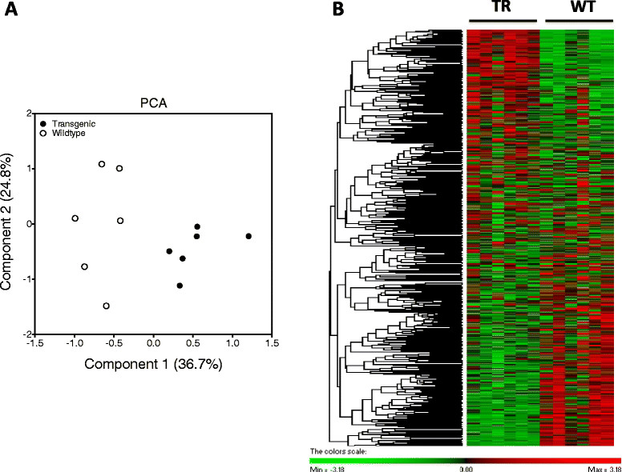
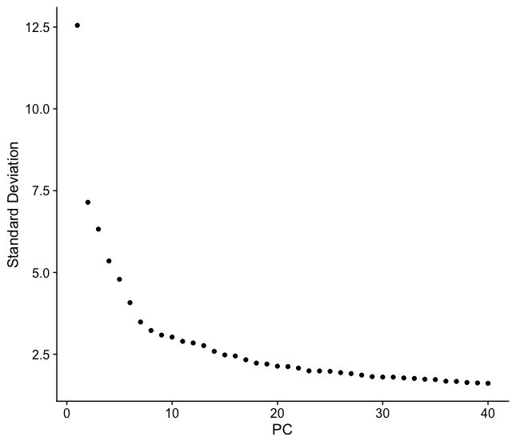
Principle Component Thresholding
Notes:
I think this figure displays nicely what we are trying to communicate when thinking about correlated features variance and what that may look like in higher order PCs. From this example we can note that the features selected for this PC are obviously deviating systematically between between Treatment and Wildtype.
However, you may ask, what PC’s do we include in our analysis. Which proves to be a interesting question, because you don’t want to exclude differences that may be biologically relevant but you also don’t want to include noise which may mistakenly skew your results.
The most common industry practice that our pipeline also utilizes is an identification of the elbow in an elbow plot of Standard Deviation for each PC. This allows us to make an automated decision regarding what variation to include and what variation in the data is just noise. So, you can see that after about 15 PC’s the the Standard Deviation begins to flatten as we move through the ranked PC’s beyond that point which we can assume is baseline noise that may not be biologically significant.

Slide 23
06
Integration
By
Group

Slide 24




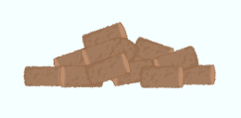
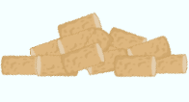

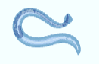
Integration Use Cases
PC 2
PC 1
Notes:
Differences in extraction protocol, or technique lead to sources of variation in samples that are supposed to be biological replicates of one another. Imagine you switched RAs and one of them has a different technique in organ extraction resulting in the inclusion or exclusion of significant anatomical features, or heck leaves the lights on in the lab longer than the other RA which may stimulate some changes in the organisms photoreceptor activity and ultimately affecting gene expression.
Another example is you may have 2 cohorts of mice that you would like to compare to one another and they are being evaluated for an affect from a given treatment. Unfortunately, the mouse room starts using a different brand of food to put the colonies on half way through cohort 1’s study. This change isn’t communicated to the group and could lead to a wide-variety of expression changes within a seemingly equally treated group.
Lastly, maybe when want to compare similar biological systems across multiple organism’s which from their underlying genomic diversity are going to vary heavily in expression profiles leading to mis-alignment of similar identity cells (mouse – heart, axolotl – heart, c.elegans – heart). To be able to make any conclusions or draw relationships with proper respect to the experiment design we need to remove any sources of variation in our sample that could lead to unwanted or unexpected differences in our annotation.

Slide 25
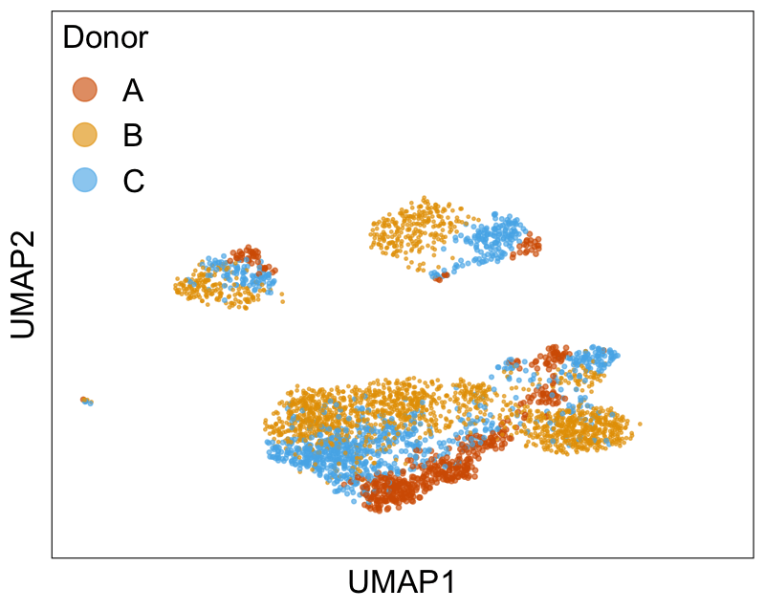
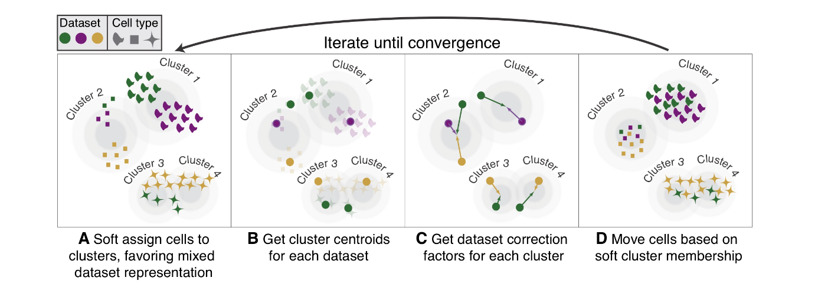
Harmony
Harmony : An algorithm that projects cells into clusters based on their cell identity rather than dataset specific conditions.
Harmony applies a transformation to the principal component values. The algorithm then determines if there is a balanced quantity of cells from each batch within the clusters. Each cell is then evaluated to see how much its batch identity influences its PC coordinates. The cells position is corrected by shifting it towards the centroid of its cluster.

Slide 26

07
Neighbors Clusters Markers
By
Group

Slide 27
K Nearest Neighbors
PC 4
PC 6
PC 2
PC 3
PC 5
PC 8
PC N-1
PC 1
PC 7
PC N
Notes:
Utilizing our updated dimensions from the PCA analysis, we need to define cells that are similar to one another to begin to draw conclusions about the composition and identity of components within the composition of our defined groupings.
In order to get defined groupings or annotations we need to be able to quantify the relationship in space between each of our cells.
To do that we construct what is called a K nearest neighbor graph which will define the nearest N number of neighbors to each cell. This is done by using some distance metric such as Euclidean distance for example within our PCA space to compute how far each cell is away from it’s K nearest neighbors. From these newly constructed edges between our cells we can begin to define groupings that arise from shared connectivity.

Slide 28
Louvain Clustering and Marker Calculation
WNT1A
WNT1B
CRX2
IL12
IL1
CD45
MPEG1
IL1
CD19
MYL34
MYF5
MMP12
APOE
C1QA
C1QB
Principle Component Space
Principle Component Space
Notes:
To further upon this idea of cluster assignment, we use a clustering algorithm like the Louvain Cluster algorithm which attempts to optimize connectivity within a community and reduce the connections across communities.
I just made a simple animation the very loosely describes what that process looks like in the context of a single cell experiment.
Initially all cells are unassigned or unannotated, then iteratively optimized for a global strength in community until we can longer move any cells around from the annotation to increase that optimization score.
Another important concept included in cluster assignment is the idea of resolution, and resolution describes how tightly our clusters are defined or how broad.
At higher resolutions the inter-connectivity threshold rules are much higher or strict, whereas at low resolutions the connection requirements to extend a clusters boundaries are much looser.
From these clusters we can then do things such as pairwise comparisons between our defined groups to parse out gene expression differences or compare them collectively to understand what is most unique to their groups identity.

Slide 29
08
Plotting
By
Group

Slide 30
Dimensional Reduction
X
Y
Y
UMAP/TSNE
X
Notes:
Laslty, and I’m not going to go into much depth on this topic as it really just another means of displaying the data in a low dimensional space, we are going to discuss some additional Dimensional reduction techniques to even further reduce the dimensions of PCs that we calculated into a 2 or 3 dimensional space.
Again we are posed with trying to represent a high dimensional space of anywhere from 4-30 PC’s into a lower dimensional easily digestible space
If we wanted to take the example above that may represent PC’s, features, genes, etc. and preserve the relationship of those cells in a 1 dimensional space we would need to collapse those dimensions. Well this doesn’t work for x or for y (tell why)
What UMAp or TSNE attempt to do is determine the probability that a data point is associated to another point though an intensive distance calculation and manipulation and use that probability to move things closer together that have a high probability and a move things farther away that have a low probability of being similar.

Slide 31
UMAP and T-SNE
Multi-Dimensional Space
Distances
UMAP/TSNE 2
UMAP/TSNE 2
UMAP/TSNE 2
Multi-Dimensional Space
UMAP/TSNE 1
UMAP/TSNE 1
UMAP/TSNE 1
Notes:
To show an example of this algorithm, we can look at an example of 3 groups that are pre-annotated. Using our High-Dimensional space of pC’s we can again calculate the same type of distances as in the nearest neighbor algorithm . Using the defined distances and number of neighbors you are expecting per cell (probably proportional to your data size) UMAp and TSNE takes each cell and embeds them into a 2d representation and then iteratively moves cells closer together that are closer in high-dimension space and farther from things that are not-so-similar.
From these transformations you end up with isolated communities that should resemble the annotations provided by the clustering algorithm.
An important thing to note however, although you can draw relationships between close or local clustering cells, the distance from farther clusters doesn’t necessarily have deterministic conclusions that can be drawn from them.

Slide 32

Questions?

